Slide 1
Drive Your Server Like You Stole It
HOTSOS 2017
Andy Weiss & Kirby Sand

Slide 2
Presentation Overview
Introduction
Problem Statement
Experiments Designed to Address Issues With Processing Large Datasets
PGA Experiments
Modifying work area size and DOP to prevent going to temp
SGA Experiments
Big Table Caching
In-Memory Column Store
Statement Queuing
Conclusions & Future Work
Acknowledgements

Slide 3
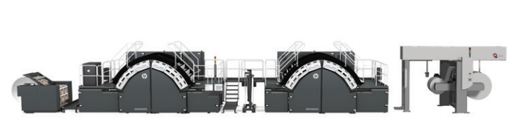
Introduction
We work for Hewlett Packard in Corvallis Oregon
We are on a team that builds really big printers
Engineering Analytics
Analytics on large datasets to provide insights to the engineering team, the tiered support organization, and to the end customer.
Failure mode detection
Machine performance
Fundamental engineering models
Our Data
Raw sensor information
temperature, pressure, speed, tension, vision system output, etc.
Device status information
Alarms, faults, compute system usage, etc.
Production information
Jobs, consumables, operator interactions, etc.
The data is linked only by the device it came from and the timestamp.

Slide 4
The Different Approaches to Tuning
The 3 R’s of query tuning
Reduce
Partition pruning, indexing, etc.
Reuse
Pre-Aggregation, Bind variables, SQL Plan Baselines, etc.
Rev It Up!
Use your resources
Sometimes you just have to crunch a lot of data…
Monthly/Weekly/Nightly/Hourly Jobs
Ad-hoc queries

Slide 5
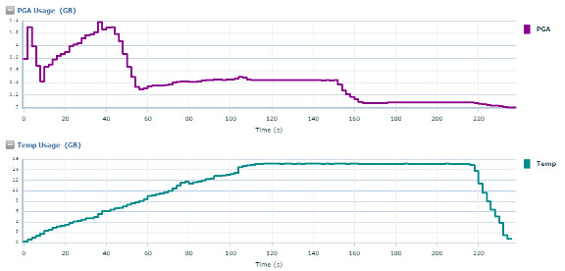
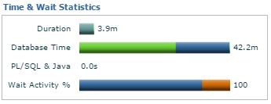
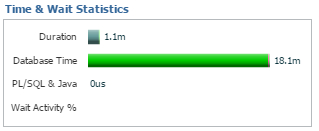
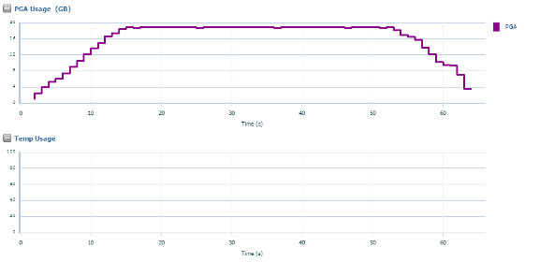
Why are we going to temp?
1.4GB PGA
11.2.0.4
PGA 800GB
72 cores
16GB Temp
Same query with a manual sort area size
19GB PGA
0 Temp

Slide 6
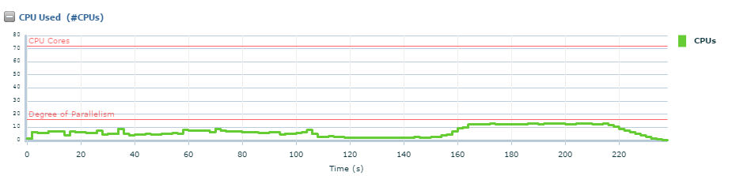
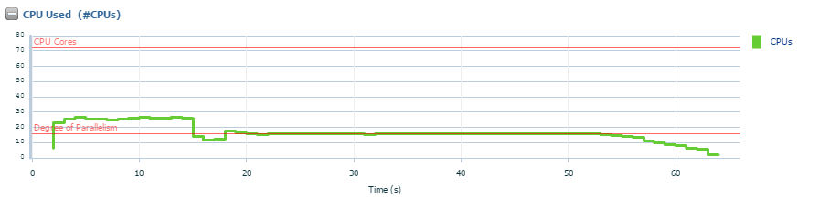
Which also causes inefficient use of CPU

Slide 7
Let’s set up a test … how hard can it be?
12.1
512G ram
16 cores
What we thought we knew
What we wanted to know
What we actually knew

Slide 8
Experiment Overview (Representative Tables & Queries)
Parent/Child Analytics
Tables
PARENT_TABLE_V1
50M Rows, 1GB
CHILD_TABLE_V1
5B rows, 100GB
Standard Analytic Functions
Avg/Sum/Count
Single Table Analytics
Tables
CAPSTONE_PARALLEL_TEST_V1
32M rows, 7GB
Standard Analytic Functions
Avg/Sum/Count
Filter Parent/Child Join
Tables
PARENT_TABLE_V1
50M Rows, 1GB
CHILD_TABLE_V1
5B rows, 100GB
Filter with WHERE clause
Windowing Functions
Tables
LEAD_LAG_TEST_V1
2.4B rows, 60GB
Windowing Functions
Lead/Lag finding changes

Slide 9
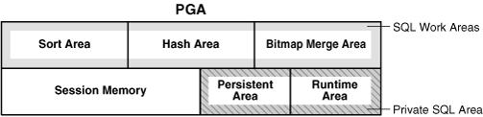
PGA Overview

Slide 10
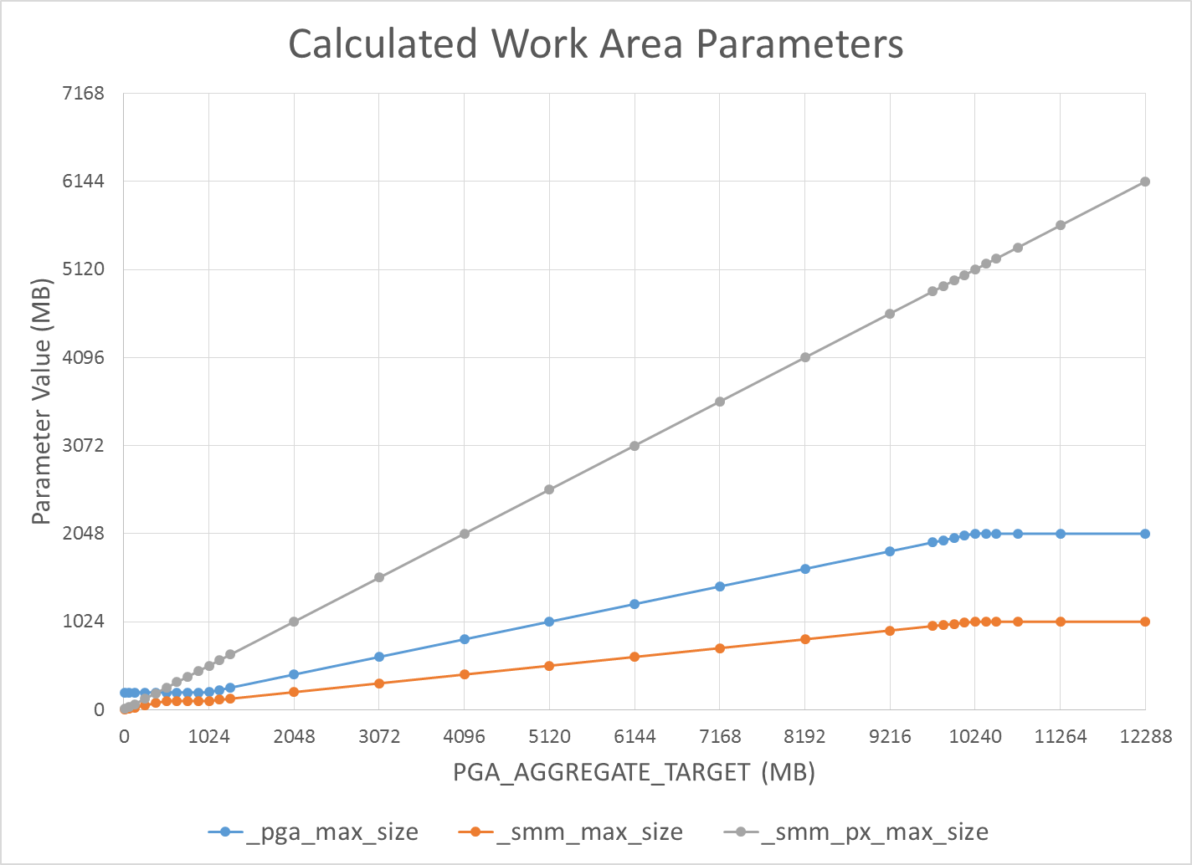
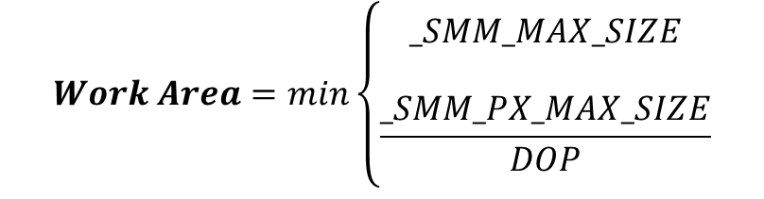
PGA Sizing Calculations
_PGA_MAX_SIZE:
PAT < 1GB: 200MB
1GB >= PAT <= 2GB: 20% of PAT
PAT > 2GB: min(2GB, 20% of PAT)
_SMM_MAX_SIZE:
PAT < 512MB: 20% of PAT
512MB >= PAT <= 1GB: 100MB
PAT > 1GB: min(1GB, 50% of _PGA_MAX_SIZE)
_SMM_PX_MAX_SIZE:
Always 50% of PAT
$$Work Area=min\left\{\begin{aligned}_SMM_MAX_SIZE \\ \\ \frac{_SMM_PX_MAX_SIZE}{DOP}\end{aligned}\right.$$

Slide 11
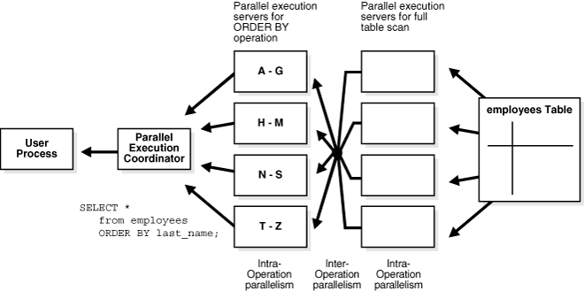
Parallel query
Areas of interest for us
Queuing
PX server pool
Granules

Slide 12
Experiment # 1: Tuning PGA
pga_aggregate_target = 192GB
_pga_max_size = 2GB
_smm_max_size = 1GB
_smm_px_max_size = 96GB
With this setup, we can never have a work area larger than 1GB.
What happens if we manually set _pga_max_size?

Slide 13
Experiment # 1: Tuning PGA
We manually set _pga_max_size
ALTER SYSTEM SET “_PGA_MAX_SIZE” = 2G
ALTER SYSTEM SET “_PGA_MAX_SIZE” = 4G
ALTER SYSTEM SET “_PGA_MAX_SIZE” = 6G
We forced DOP with a hint
/*+ PARALLEL(16) */
/*+ PARALLEL(32) */
/*+ PARALLEL(64) */
We forced buffer cache to be small
512MB (no table fits)
We tracked resource usage
Work Area Size (PGA and Temp)
V$SQL_WORKAREA_ACTIVE
Time (Run Time, CPU Time, IO Wait, DB Time)
Can we stop going to temp if we enable larger work areas?

Slide 14
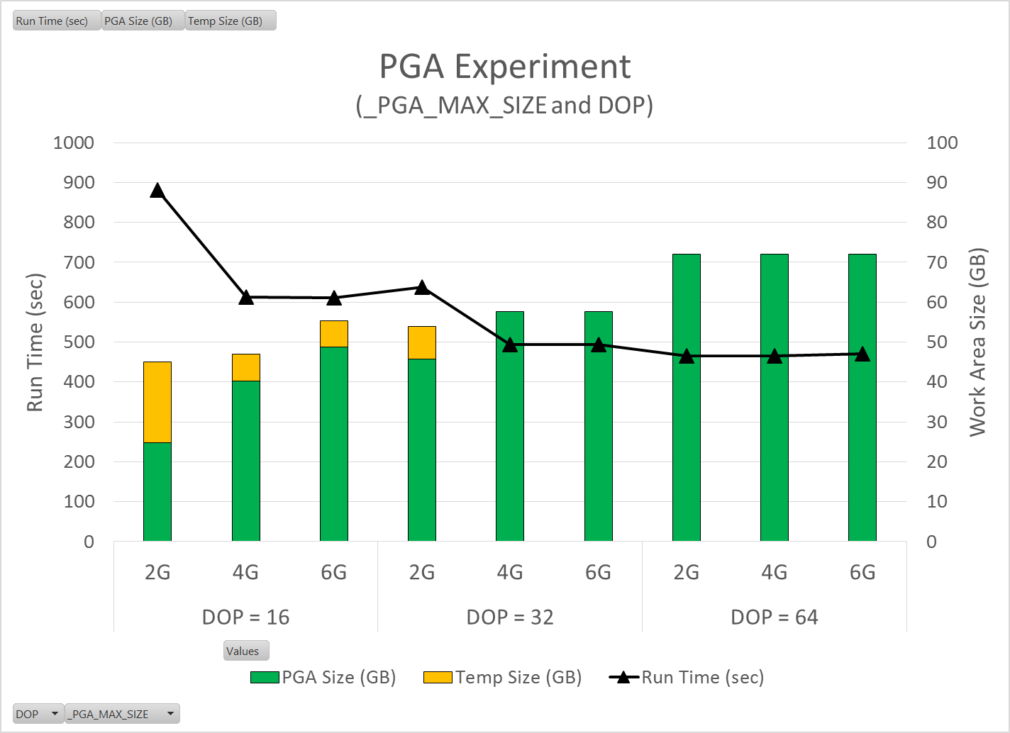
Experiment # 1: Tuning PGA
Biggest gains happen when we never go to temp.
Approx. 1.3X improvement over default
How do we prevent TEMP?
Really high DOP
Not ideal, requires lots of CPU without a big improvement in run time.
4G PGA_MAX_SIZE
A more attractive approach. Allows us to use more PGA
Somewhat scary since it’s an undocumented parameter
Default

Slide 15
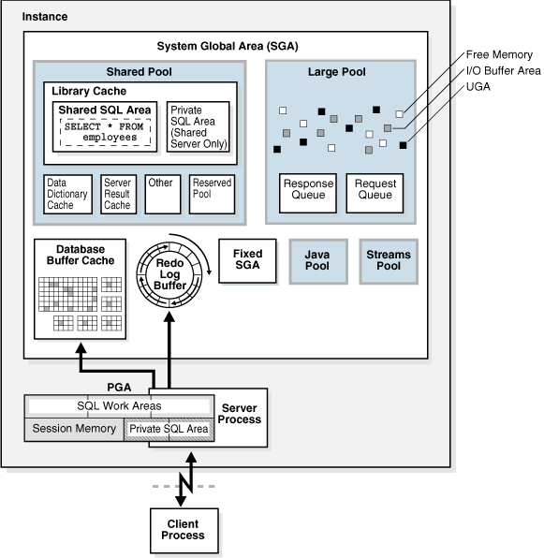
SGA Overview
Quick refresher on SGA memory structures
Areas of interest for us
Buffer Cache
In-Memory Column Store

Slide 16
Experiment # 2: Big Table Caching
We manually set parallel degree policy
ALTER SYSTEM SET PARALLEL_DEGREE_POLICY = MANUAL
ALTER SYSTEM SET PARALLEL_DEGREE_POLICY = AUTO
We manually set Big Table cache percent target
ALTER SYSTEM SET DB_BIG_TABLE_CACHE_PERCENT_TARGET = 10
ALTER SYSTEM SET DB_BIG_TABLE_CACHE_PERCENT_TARGET = 50
ALTER SYSTEM SET DB_BIG_TABLE_CACHE_PERCENT_TARGET = 90
We forced DOP with a hint
/*+ PARALLEL(32) */
We forced PGA_MAX_SIZE
ALTER SYSTEM SET “PGA_MAX_SIZE” = 4G
We made buffer cache big
192GB
We tracked resource usage
Time (Run Time, CPU Time, IO Wait, DB Time)
BT Cache Object Status
V$BT_SCAN_OBJ_TEMPS
Can we put tables into memory and eliminate or minimize IO?

Slide 17
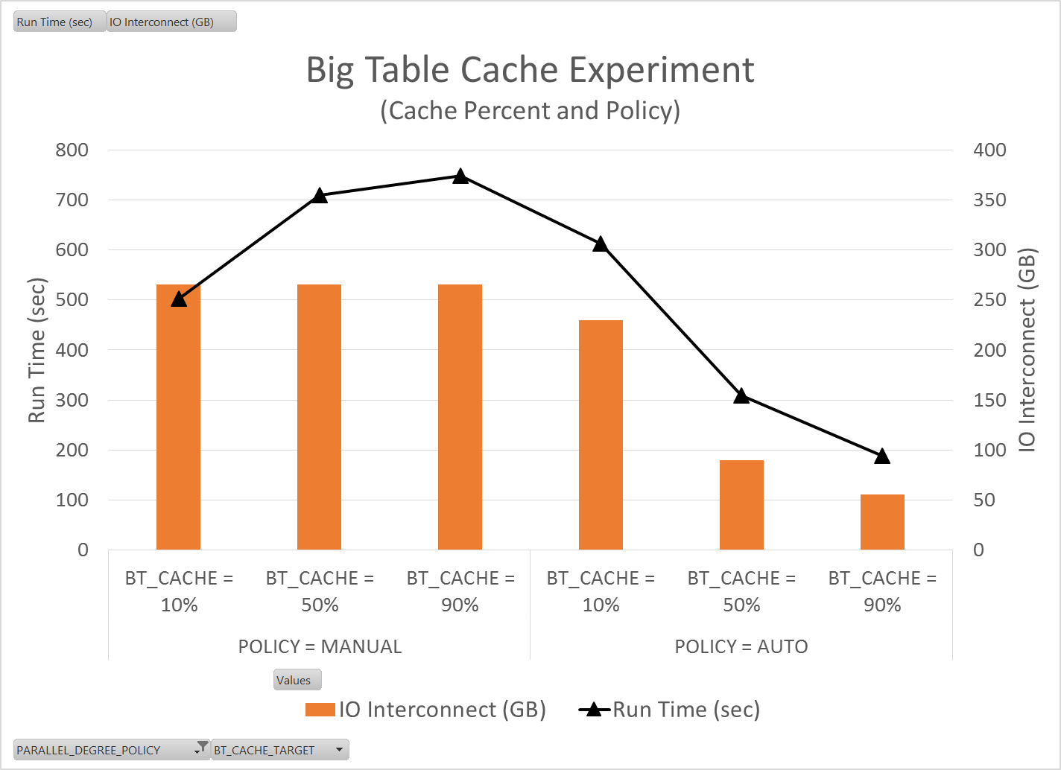
Experiment # 2: Big Table Caching
Policy = Manual
Notice that as the cache percent target gets large, the queries slow significantly. Big tables do appear to go into the standard buffer cache
Policy = Auto/Adaptive
As you increase the big table cache percent you get significant query speed improvements.
4.7X speed improvement from worst case
2.6X speed improvement from the default
However, you still have to go disk for some of the data.

Slide 18
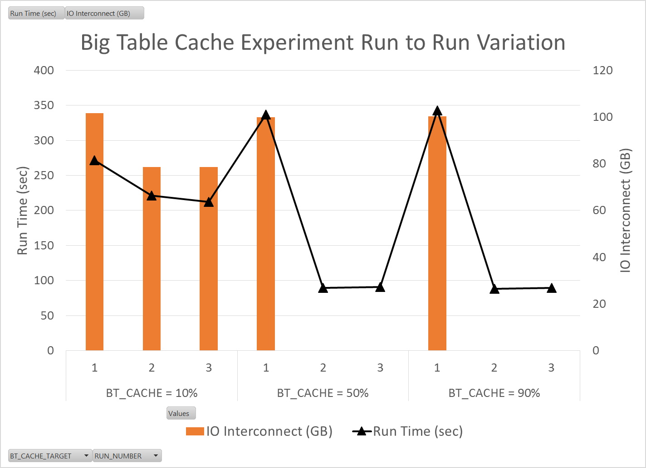
Experiment # 2: Big Table Caching
Notice that you appear to pay a penalty on the first run, but if your buffer cache is large enough you really reap the benefits of the subsequent runs.

Slide 19
Experiment # 3: In-Memory Column Store
We manually set parallel degree policy
ALTER SYSTEM SET PARALLEL_DEGREE_POLICY = AUTO
We manually set InMemory Size
ALTER SYSTEM SET INMEMORY_SIZE=192G SCOPE=SPFILE
We forced DOP with a hint
/*+ PARALLEL(32) */
We forced PGA_MAX_SIZE
ALTER SYSTEM SET “PGA_MAX_SIZE” = 4G
We backed off on buffer cache size
ALTER SYSTEM SET DB_CACHE_SIZE = 32G SCOPE=SPFILE
We forced tables to be InMemory
ALTER TABLE [table name] INMEMORY MEMCOMPRESS FOR QUERY LOW PRIORITY CRITICAL
We waited for the table to fully populate InMemory
V$IM_SEGMENTS
We tracked resource usage
Time (Run Time, CPU Time, IO Wait, DB Time)
How does IM compression change query speed?
How does compression option change object size in memory?

Slide 20
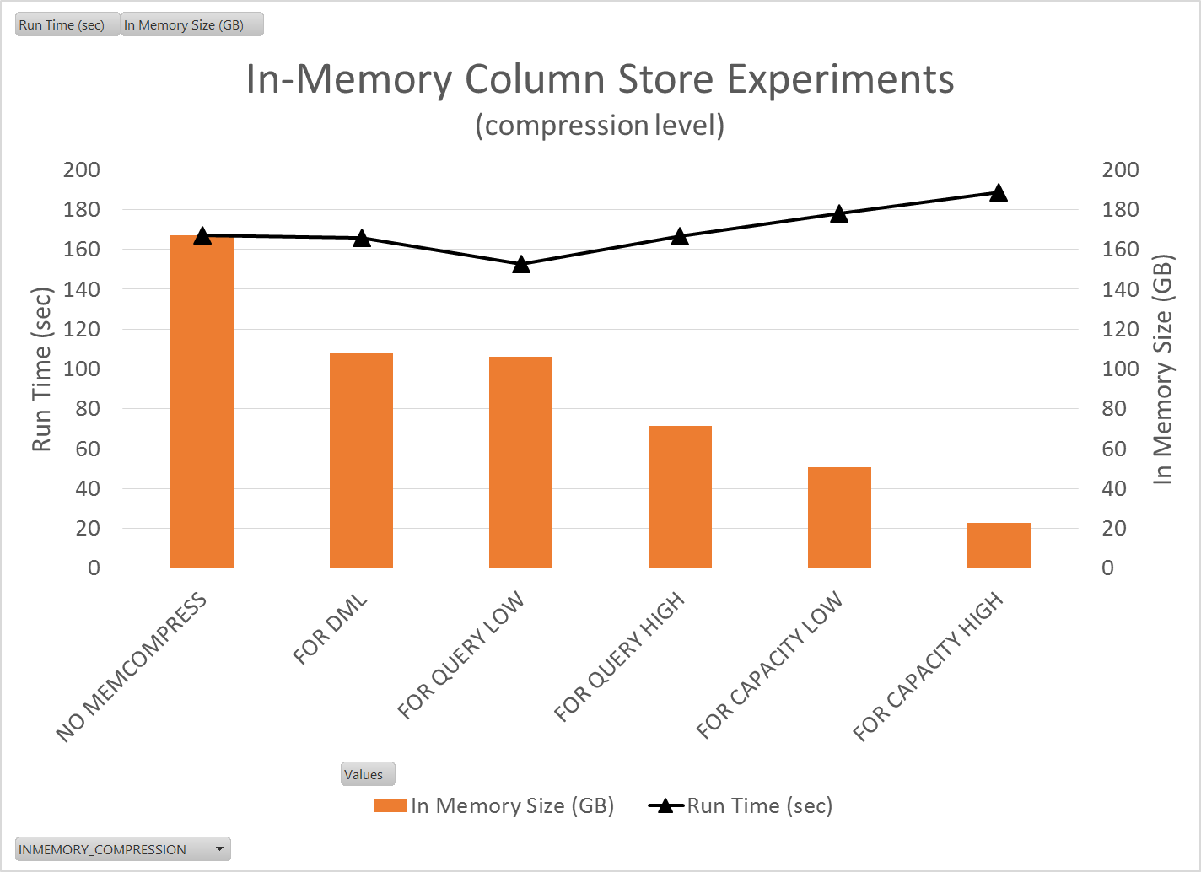
Experiment # 3: In-Memory Column Store
“For Query Low” looks like a great choice
Best performance (153 sec)
Decent compression (37% reduction)
For huge tables you could do “For Capacity High” so as not to use up all your In-Memory space.
Still get a 2.6X improvement over going to disk

Slide 21
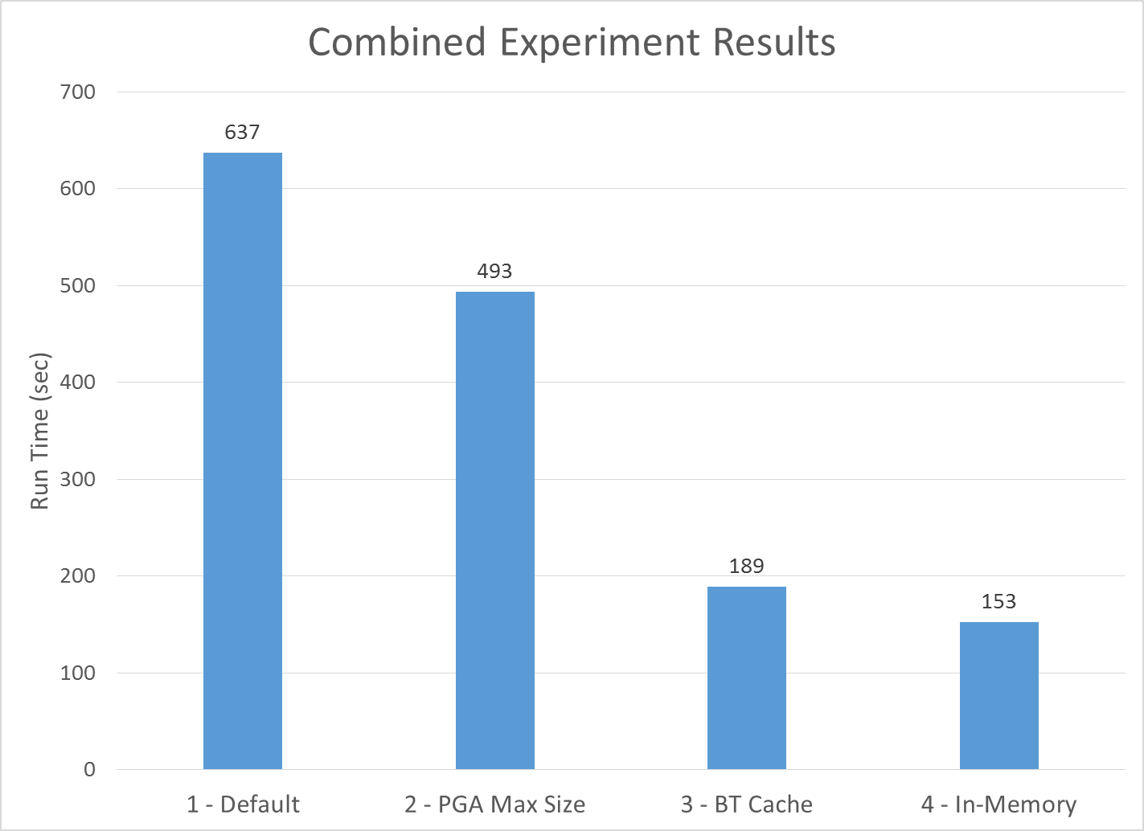
Let’s Put It All Together…
Summary
23% improvement from not going to temp
70% improvement from also caching big tables
76% improvement from using In-Memory
One Big Caveat…
All experiments were run serially
No competition for resources
No other work being done on the system
Not a real-world test case
So lets do a bunch of stuff all at once and see what happens…

Slide 22
Experiment # 4: Statement Queuing

Slide 23
Conclusions
Going to temp is bad
Changing _PGA_MAX_SIZE allows us to increase our work area size without drastically increasing our DOP
Putting data into memory is good
Big table caching is a good alternative if you don’t have Oracle 12c or if you don’t want to pay for the In-Memory option
In-Memory column store is very performant

Slide 24
Future Work
What we still want to learn
What we think we know
What we probably don’t fully understand

Slide 25
Future Work
What happens with…
Partitioning and parallel queries
Table compression and parallel queries
Indexing and In-Memory
DML and In-Memory

Slide 26
Acknowledgements
Hotsos!
OSU Computer Science Students
Nathaniel Whitlock
Nic Desilets
All the great Oracle Bloggers
Kerry Osborn
Tanel Poder
Jonathan Lewis

